Slide 1

Bandwidth efficient object recognition for drone swarms
School of Computer Science and Communication Systems
Master in Computer Science
Supervised by
Prof. Dario Floreano
Dr. Giuseppe Cocco
Fabian Schilling
Student
Marco Zoveralli
École polytechnique fédérale de Lausanne – A.Y. 2018/2019 – Marco Zoveralli – Sciper N. 267476

Slide 2
Project Overview
Motivation
Detection Accuracy: prediction by single drone may be unreliable
Consensus: autonomous swarms may need to agree on whether a given target is present
Bandwidth efficiency: especially relevant in urban environment
Goal
Determine the presence/absence of a target object with high accuracy
Proposed approach
Exploit multiple viewpoints
Estimations are done locally by each drone
Final vote sent to a base station
Limited information exchange to save power, bandwidth and for scalability
What? – Related Work – How? – Validation – Conclusion
École polytechnique fédérale de Lausanne – A.Y. 2018/2019 – Marco Zoveralli – Sciper N. 267476
1/11
1/13
Notes:
When considering a set of devices performing object recognition, a swarm of drones in our case, what can happen is that some drone cannot predict the presence or absence of the object in a too reliable way. This is where a distributed solution comes into help: the devices that are part of the swarm put together the single predictions in order to get a more reliable one. One of the main requirements when considering such approaches, besides improving the accuracy of the predictions, is to save bandwidth.

Slide 3
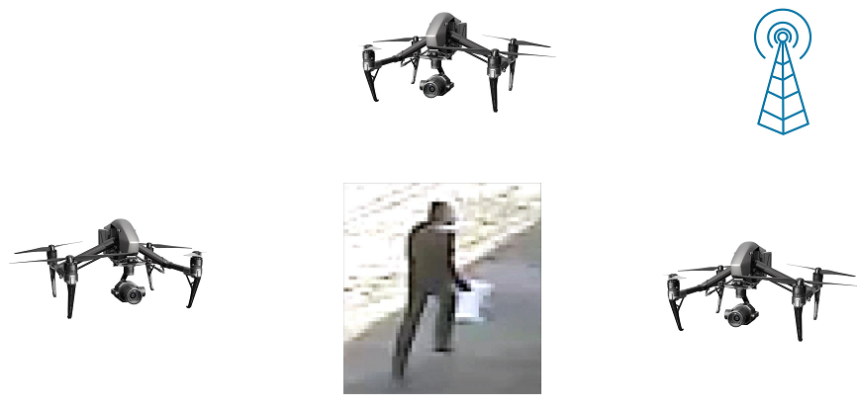
Project Overview
Motivation
Detection Accuracy: prediction by single drone may be unreliable
False positives and false negatives can occur
Consensus: autonomous swarms may need to agree on whether a given target is present
Bandwidth efficiency: especially relevant in urban environment
Goal
Determine the presence/absence of a target object with high accuracy
Introduction – Related Work – How? – Experiments – Conclusion
École polytechnique fédérale de Lausanne – A.Y. 2018/2019 – Marco Zoveralli – Sciper N. 267476
1/11
1/12
Notes:
When considering a set of devices performing object recognition, a swarm of drones in our case, what can happen is that some drone cannot predict the presence or absence of the object in a too reliable way. This is where a distributed solution comes into help: the devices that are part of the swarm put together the single predictions in order to get a more reliable one. One of the main requirements when considering such approaches, besides improving the accuracy of the predictions, is to save bandwidth.

Slide 4
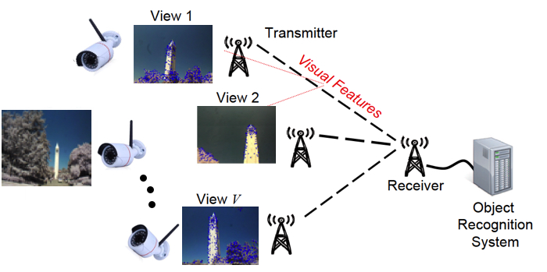
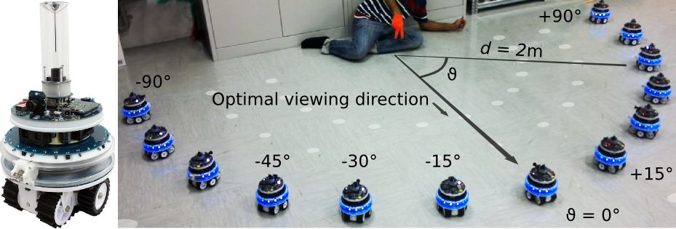
Related Work
A. Rahimpour et al., “Distributed Object Recognition in Smart Camera Networks”, 2016 IEEE Int. Conf. on Image Processing (ICIP), 2016.
Feature extraction performed by each camera
Features sent to a base station, which performs
object detection → no autonomy of devices
Lack of an autonomous set of devices that
triggers other events
J. Lee et al., “Real-Time Object Detection for Unmanned Aerial Vehicles based on Cloud-based Convolutional Neural Networks”, First IEEE International Conference on Robotic Computing (IRC), 2017.
Cloud-based object detection
Applied to aerial vehicles, but no data aggregation
A. Giusti et al., "Cooperative sensing and recognition by a swarm of mobile robots“, IEEE/RSJ International Conference on Intelligent Robots and Systems, 2012.
Interesting communication and consensus
Human-computer interaction
Different setup, different goal
Classification task
Introduction – Related Work – How? – Experiments – Conclusion
École polytechnique fédérale de Lausanne – A.Y. 2018/2019 – Marco Zoveralli – Sciper N. 267476
1/11
2/12
Notes:
Different assumption for giusti’s paper: they assume that while the protocol is running, the object is indeed there. Instead, we have to determine whether an object is there: there might be nothing as well.

Slide 5
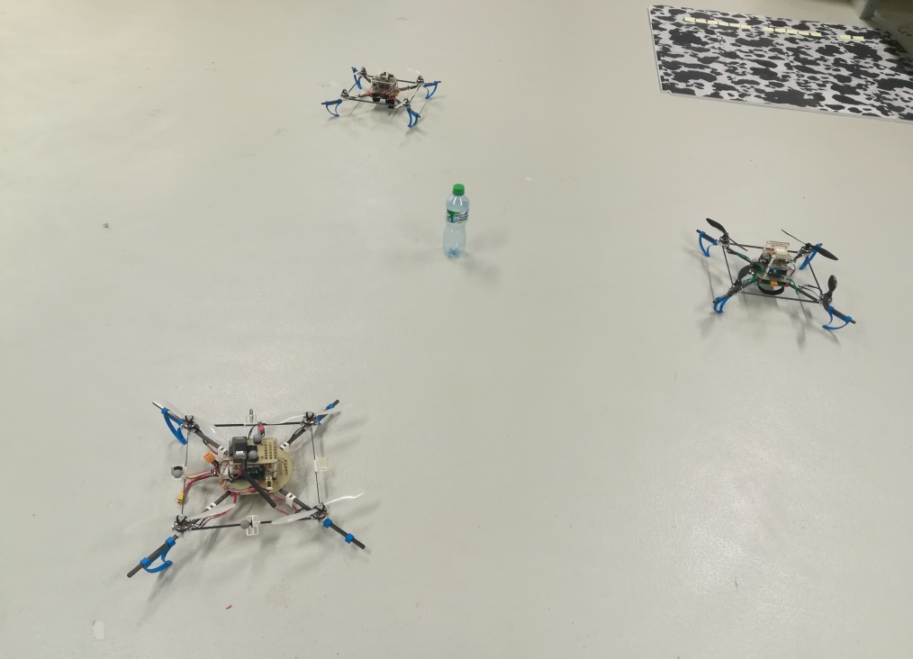
Simple Network Management Protocol
Hardware Selection and Validation
Hardware selection
Project inputs
Single-board computers: Odroid XU4
Image Acquisition: M7 camera
Our proposal
Connectivity: WiFi Module 5
Hardware validation
Connectivity tests
Adhoc mode compatibility
Network throughput
Network stability
Object detection tests
Setup of a machine learning framework on the ARMv7 architecture
MSCOCO pre-trained neural network
Average computational time: 200ms per prediction
Accurate predictions over a defined set of objects (e.g. bottle, keyboard)
What? – Related Work – How? – Validation – Conclusion
École polytechnique fédérale de Lausanne – A.Y. 2018/2019 – Marco Zoveralli – Sciper N. 267476
3/13
Notes:
What does model checking do? A little background.

Slide 6
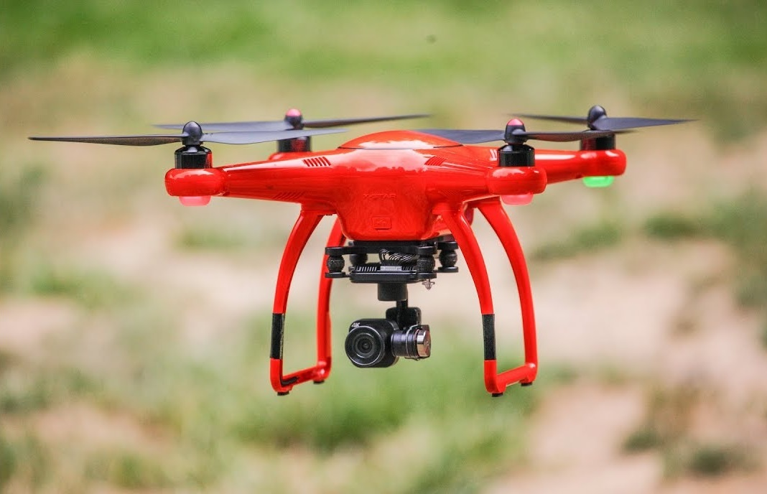
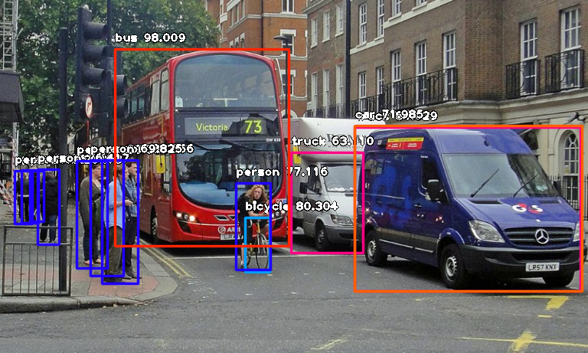
Simple Network Management Protocol
Hardware Selection and Validation
Hardware selection
Single-board computers: Odroid XU4
Image Acquisition: OpenMV M7
Connectivity: WiFi Module 5
Connectivity tests
Adhoc mode compatibility
Network throughput
Network stability
Object detection tests
Setup of a deep learning framework
MSCOCO pre-trained neural network
Introduction – Related Work – How? – Experiments – Conclusion
École polytechnique fédérale de Lausanne – A.Y. 2018/2019 – Marco Zoveralli – Sciper N. 267476
3/12
Notes:
What does model checking do? A little background.

Slide 7
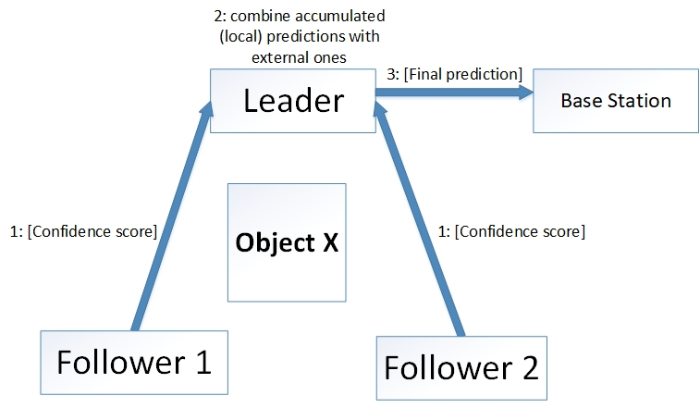
Protocol Design: Inter-host Communication
Intra-host
Inter-host
Aggregate local predictions with received ones
Weighted average over the set of predictions
Emission of final result
Challenges
Give the proper weight to each device’s prediction
Reach a consensus
Handle packet losses
Introduction – Related Work – How? – Experiments – Conclusion
École polytechnique fédérale de Lausanne – A.Y. 2018/2019 – Marco Zoveralli – Sciper N. 267476
1/11
4/12
Notes:
Infer about BIP, say that we discuss later about the tools

Slide 8
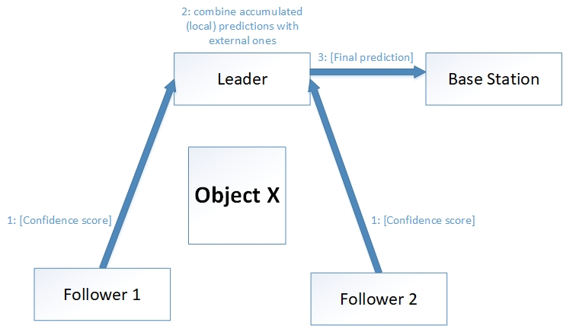
Protocol Design: Inter-host Communication
Intra-host
Inter-host
Aggregate local predictions with received ones
Weighted average over the set of predictions
Emission of final result
Challenges
Give the proper weight to each device’s prediction
Reach a consensus
Handle packet losses
What? – Related Work – How? – Validation – Conclusion
École polytechnique fédérale de Lausanne – A.Y. 2018/2019 – Marco Zoveralli – Sciper N. 267476
1/11
4/13
Notes:
Infer about BIP, say that we discuss later about the tools

Slide 9
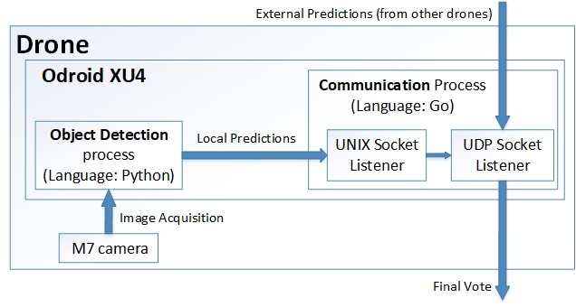
Protocol Design: Intra-host Computations
What? – Related Work – How? – Validation – Conclusion
École polytechnique fédérale de Lausanne – A.Y. 2018/2019 – Marco Zoveralli – Sciper N. 267476
1/11
5/13
Notes:
Infer about BIP, say that we discuss later about the tools

Slide 10
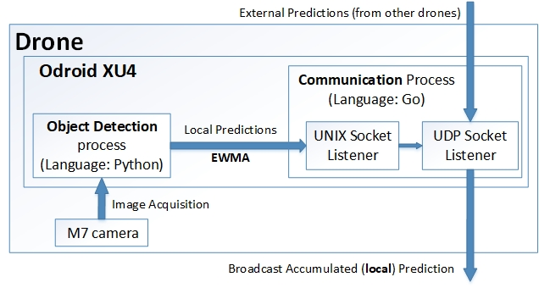
Protocol Design: Intra-host Computations
Introduction – Related Work – How? – Experiments – Conclusion
École polytechnique fédérale de Lausanne – A.Y. 2018/2019 – Marco Zoveralli – Sciper N. 267476
1/11
5/12
Notes:
Infer about BIP, say that we discuss later about the tools

Slide 11
Protocol Design: Leader Election
Assumption: the number of hosts (N) in the network is known
Any host can be the leader
As long it knows who the leader is
One leader per round
It changes at each round
More system resiliency
Very simple mechanism
Leader ID = Round ID % N
N = #hosts
The leader classifies an object as present iff #positive predictions > M
M = N/K
Introduction – Related Work – How? – Experiments – Conclusion
École polytechnique fédérale de Lausanne – A.Y. 2018/2019 – Marco Zoveralli – Sciper N. 267476
1/11
6/12
Notes:
Infer about BIP, say that we discuss later about the tools

Slide 12
Protocol Design: Exchanged Messages
Probe
Status
Final Prediction
Acknowledgement
Start Round
Limited amount of exchanged messages
N-1 probes messages → 1 single broadcast
N-1 status messages
1 final vote
N-1 start round messages → 1 single broadcast
What? – Related Work – How? – Validation – Conclusion
École polytechnique fédérale de Lausanne – A.Y. 2018/2019 – Marco Zoveralli – Sciper N. 267476
1/11
7/13
Notes:
Infer about BIP, say that we discuss later about the tools

Slide 13
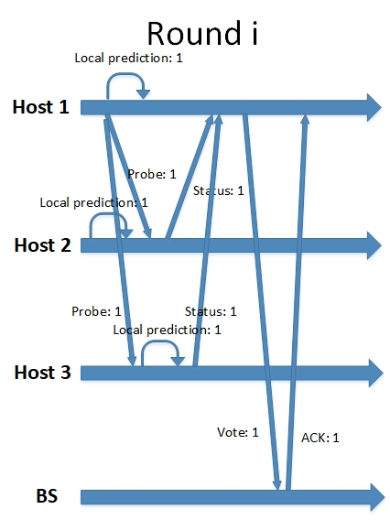
Protocol: Execution Example
Limited amount of exchanged messages
N-1 probes messages → 1 single broadcast
N-1 status messages
1 final vote + ACK
N-1 start round messages → 1 single broadcast
Introduction – Related Work – How? – Experiments – Conclusion
École polytechnique fédérale de Lausanne – A.Y. 2018/2019 – Marco Zoveralli – Sciper N. 267476
1/11
8/12
Notes:
Infer about BIP, say that we discuss later about the tools

Slide 14
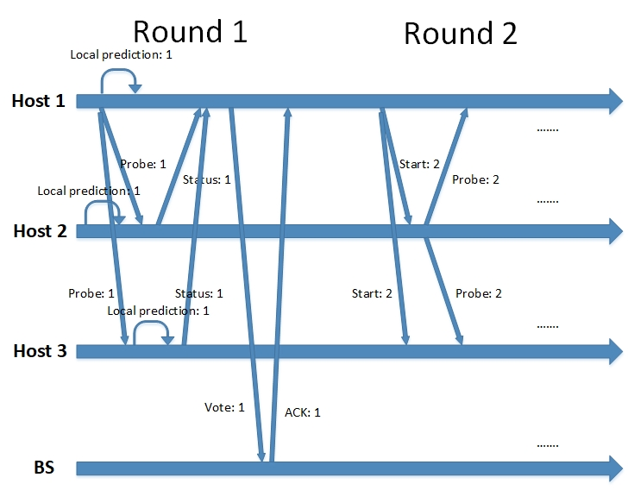
Protocol: Execution Example
What? – Related Work – How? – Validation – Conclusion
École polytechnique fédérale de Lausanne – A.Y. 2018/2019 – Marco Zoveralli – Sciper N. 267476
1/11
8/13
Notes:
Infer about BIP, say that we discuss later about the tools

Slide 15
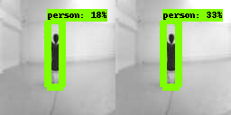
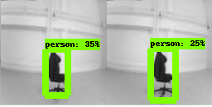
Protocol Validation: Data Fusion
Precision: TP / (TP+FP)
High if there are few false positives
Recall: TP / (TP + FN)
High if there are few false negatives
Two scenarios
With the real object
Not all optimal views
With the fake object
Some views resemble the real object
Simulation
Take K pictures
Fix N
For each possible combination of N hosts in K positions (for a total of Ck,n), compute the prediction with the data fusion mechanism
Introduction – Related Work – How? – Experiments – Conclusion
École polytechnique fédérale de Lausanne – A.Y. 2018/2019 – Marco Zoveralli – Sciper N. 267476
1/11
9/12
Notes:
Our model is good at detecting people ➔ we will try to detect a person
… data fusion mechanism, meaning that the system will detect the object as present iff #positive votes > M

Slide 16
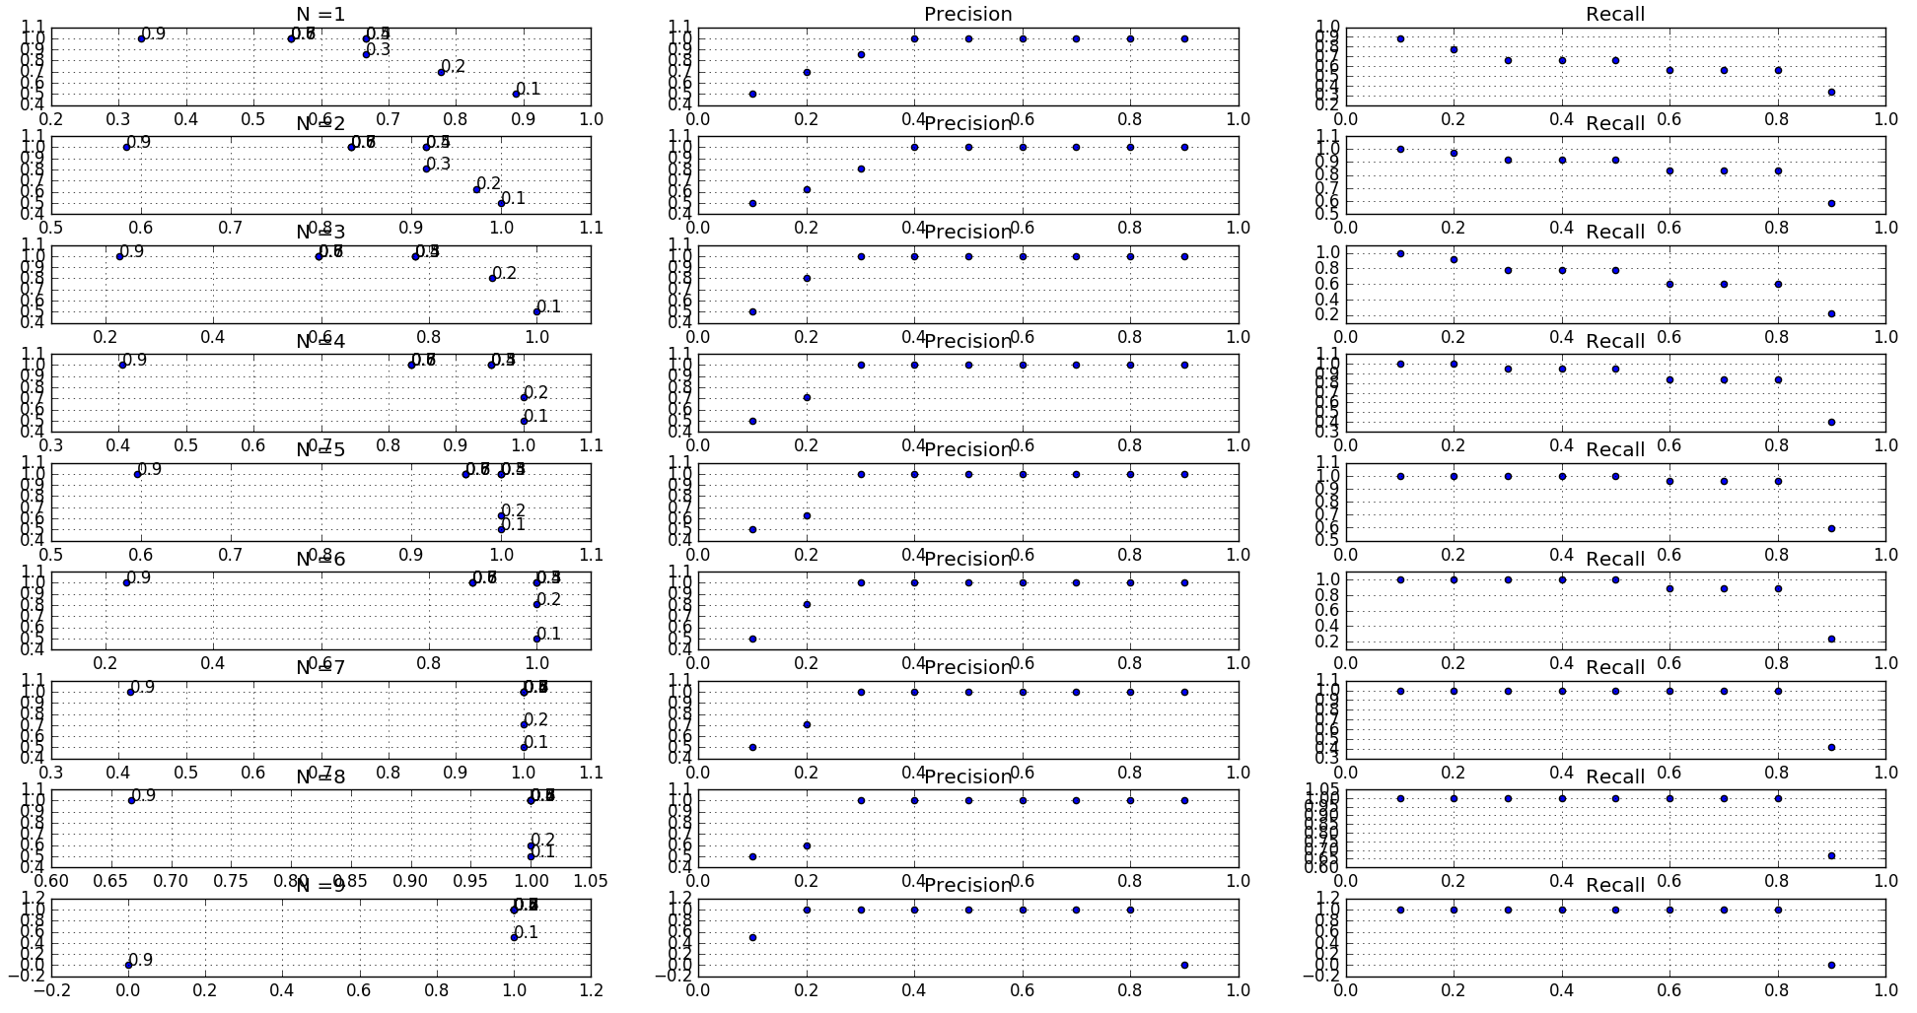
Protocol Validation: Data Fusion
What? – Related Work – How? – Validation – Conclusion
École polytechnique fédérale de Lausanne – A.Y. 2018/2019 – Marco Zoveralli – Sciper N. 267476
1/11
10/13
Notes:
Our model is good at detecting people ➔ we will try to detect a person

Slide 17
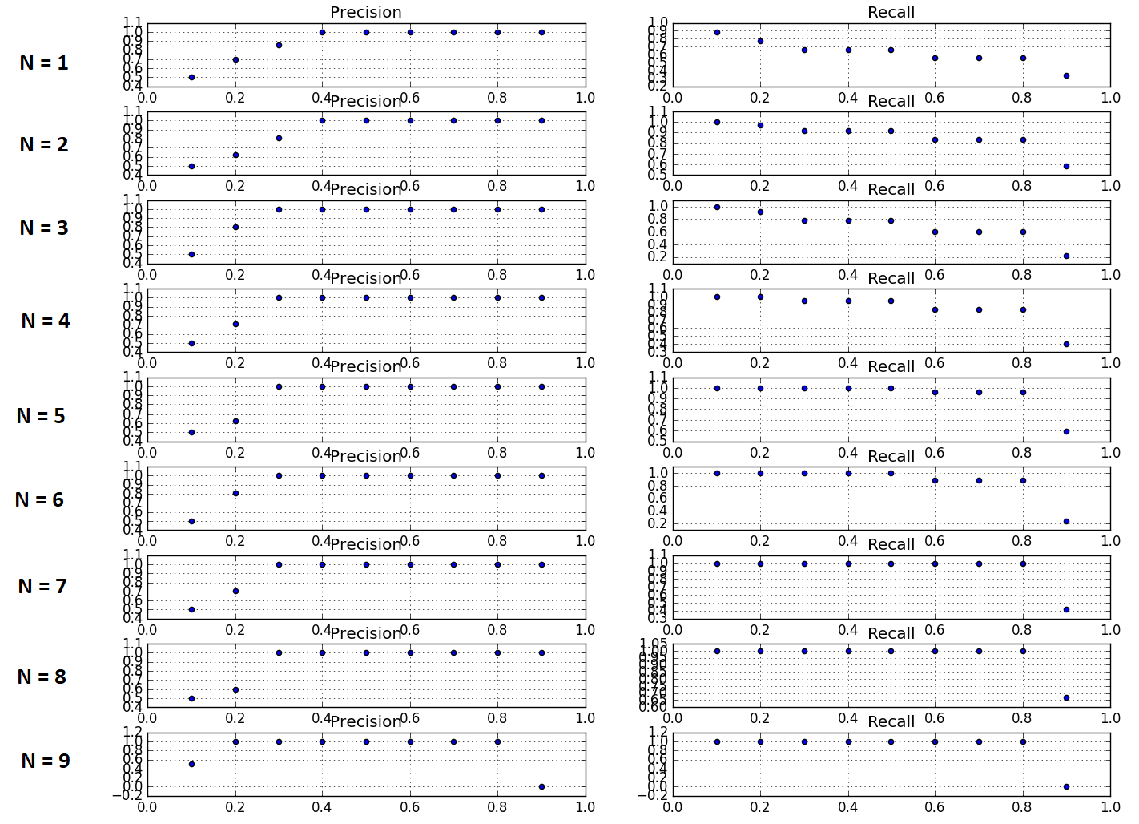
Protocol Validation: Data Fusion
What? – Related Work – How? – Validation – Conclusion
École polytechnique fédérale de Lausanne – A.Y. 2018/2019 – Marco Zoveralli – Sciper N. 267476
1/11
10/13
Notes:
Our model is good at detecting people ➔ we will try to detect a person

Slide 18
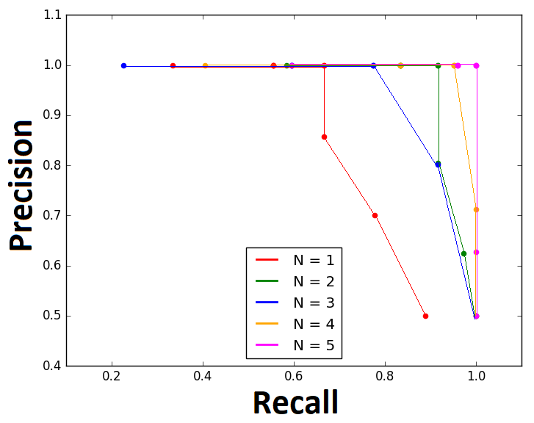
Protocol Validation: Data Fusion, P(loss) = 0
Introduction – Related Work – How? – Experiments – Conclusion
École polytechnique fédérale de Lausanne – A.Y. 2018/2019 – Marco Zoveralli – Sciper N. 267476
1/11
10/12
Notes:
Our model is good at detecting people ➔ we will try to detect a person

Slide 19
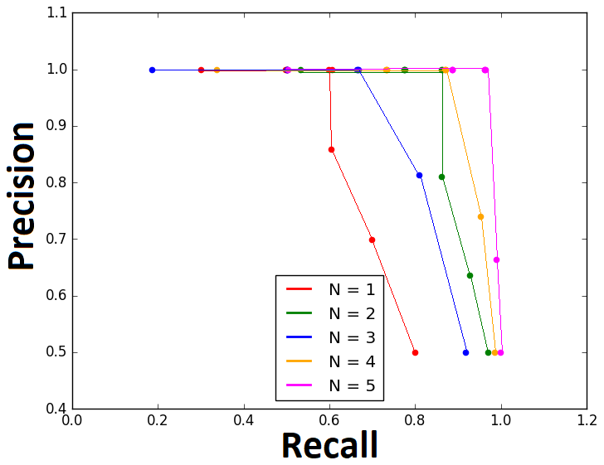
Protocol Validation: Data Fusion, P(loss) = 10%
Introduction – Related Work – How? – Experiments – Conclusion
École polytechnique fédérale de Lausanne – A.Y. 2018/2019 – Marco Zoveralli – Sciper N. 267476
1/11
10/12
Notes:
Our model is good at detecting people ➔ we will try to detect a person

Slide 20
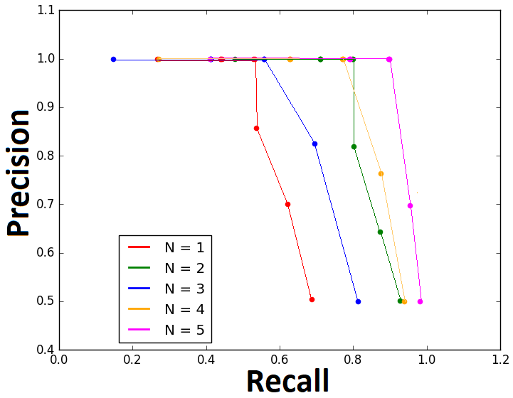
Protocol Validation: Data Fusion, P(loss) = 20%
Introduction – Related Work – How? – Experiments – Conclusion
École polytechnique fédérale de Lausanne – A.Y. 2018/2019 – Marco Zoveralli – Sciper N. 267476
1/11
10/12
Notes:
Our model is good at detecting people ➔ we will try to detect a person

Slide 21
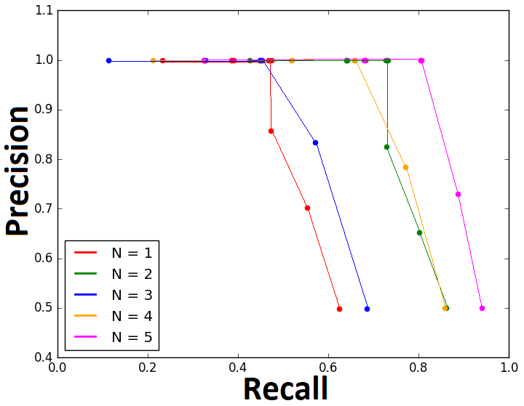
Protocol Validation: Data Fusion, P(loss) = 30%
Introduction – Related Work – How? – Experiments – Conclusion
École polytechnique fédérale de Lausanne – A.Y. 2018/2019 – Marco Zoveralli – Sciper N. 267476
1/11
10/12
Notes:
Our model is good at detecting people ➔ we will try to detect a person

Slide 22
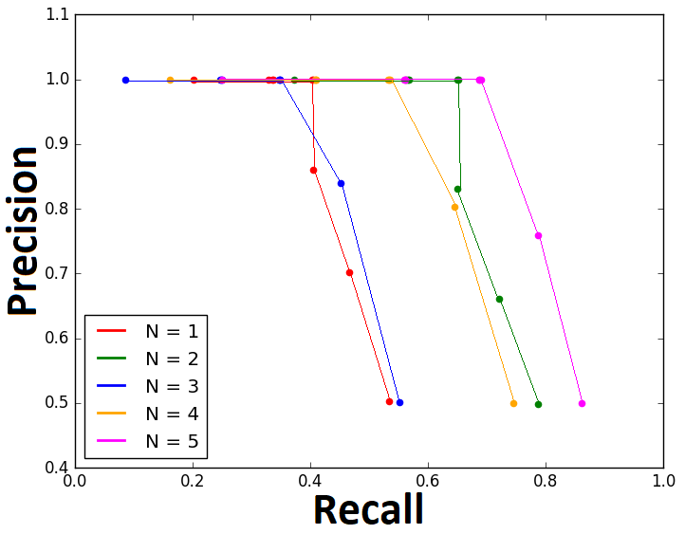
Protocol Validation: Data Fusion, P(loss) = 40%
Introduction – Related Work – How? – Experiments – Conclusion
École polytechnique fédérale de Lausanne – A.Y. 2018/2019 – Marco Zoveralli – Sciper N. 267476
1/11
10/12
Notes:
Our model is good at detecting people ➔ we will try to detect a person

Slide 23
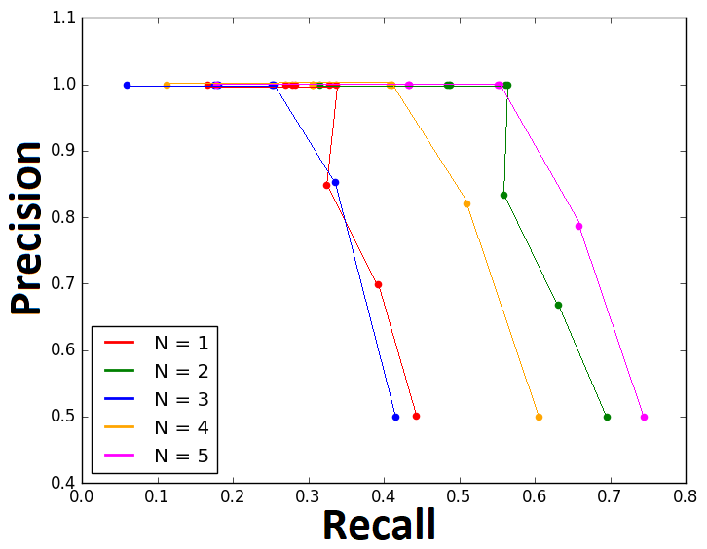
Protocol Validation: Data Fusion, P(loss) = 50%
Introduction – Related Work – How? – Experiments – Conclusion
École polytechnique fédérale de Lausanne – A.Y. 2018/2019 – Marco Zoveralli – Sciper N. 267476
1/11
10/12
Notes:
Our model is good at detecting people ➔ we will try to detect a person

Slide 24
Protocol Validation: Protocol Convergence
Simple setup
Three devices
Same object as data aggregation validation
Two distinct runs
With the real object
False negatives eliminated
With the fake object
False positives eliminated
Introduction – Related Work – How? – Experiments – Conclusion
École polytechnique fédérale de Lausanne – A.Y. 2018/2019 – Marco Zoveralli – Sciper N. 267476
1/11
11/12
Notes:
Infer about BIP, say that we discuss later about the tools

Slide 25

Conclusion
Distributed object detection system implemented
Implemented from scratch
Scalable and modular system
Improvements over single-host system have been shown
Main goal achieved
Future Work
Gather more data
Re-train the model
Deploy the protocol on more devices
Perform tests on flying/moving drones
Introduction – Related Work – How? – Experiments – Conclusion
École polytechnique fédérale de Lausanne – A.Y. 2018/2019 – Marco Zoveralli – Sciper N. 267476
1/11
12/12
Notes:
More data could have given stronger results
Only 9 different views were considered for the data validation
More devices could have shown more usefulness
Only 3 drones/Odroids were available

Slide 26
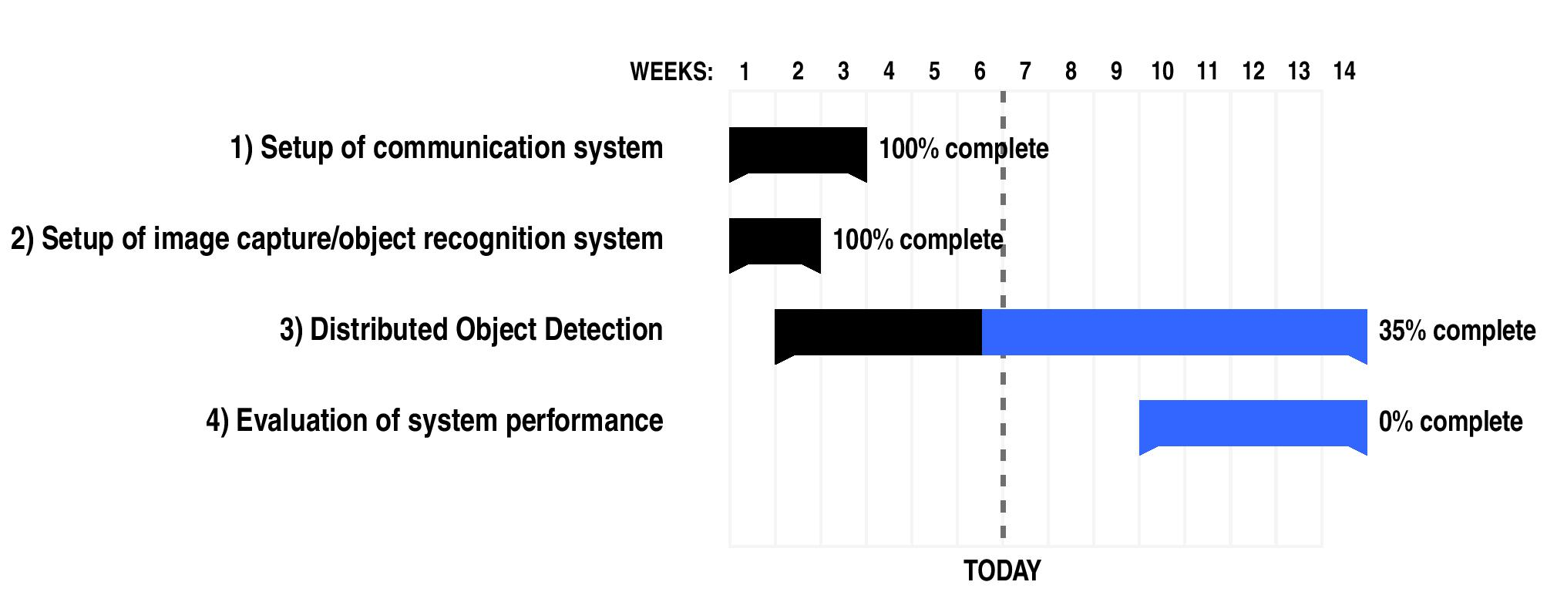
Progress
What? – Related Work – How? – Progress
École polytechnique fédérale de Lausanne – A.Y. 2018/2019 – Marco Zoveralli – Sciper N. 267476
1/11
7/7
Notes:
Infer about BIP, say that we discuss later about the tools

Slide 27
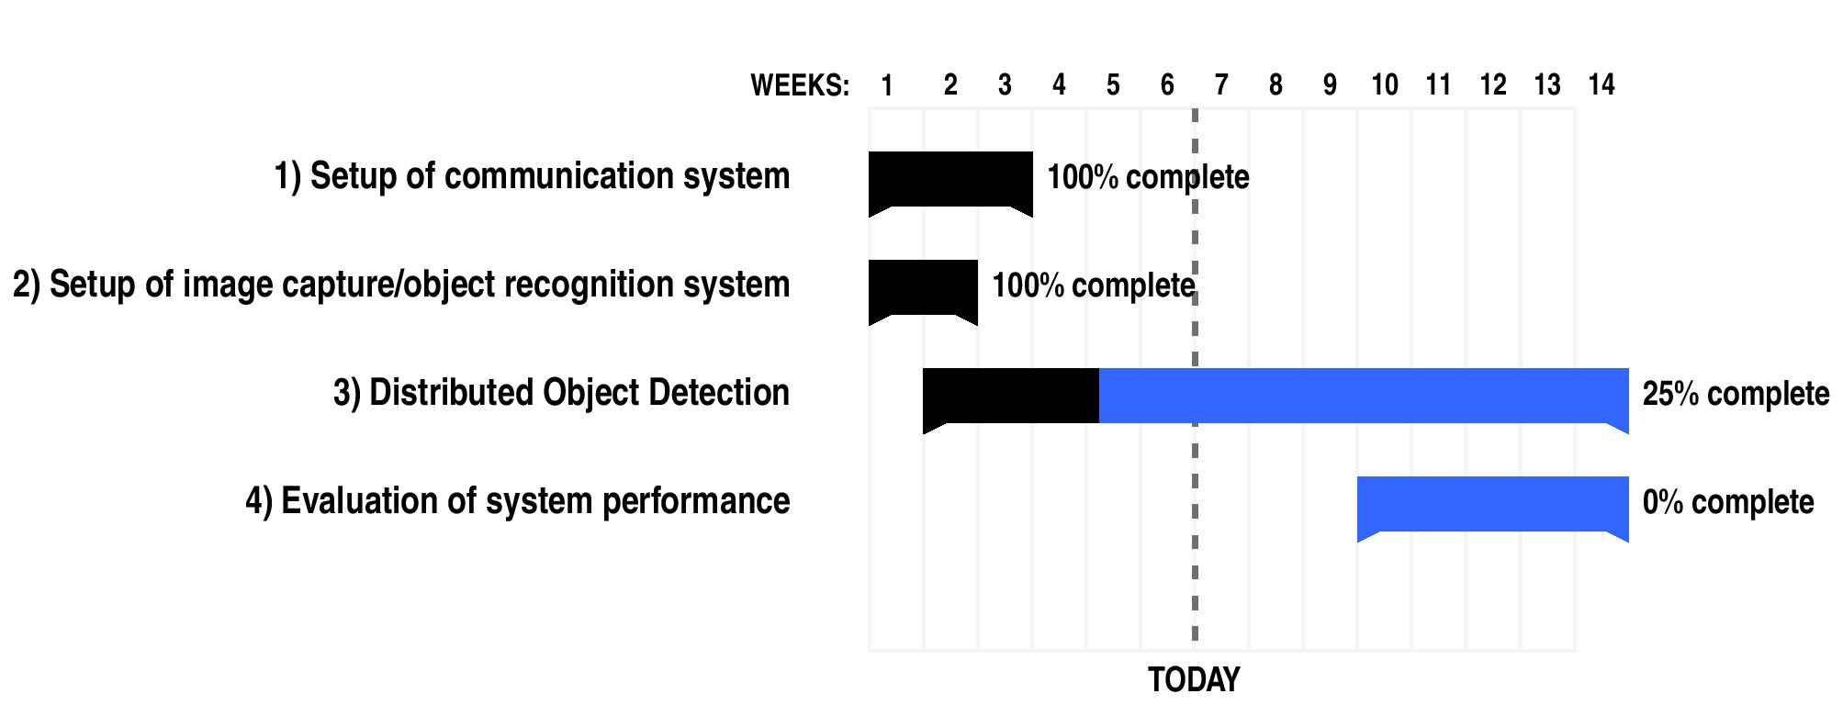
Progress
What? – Related Work – How? – Progress
École polytechnique fédérale de Lausanne – A.Y. 2018/2019 – Marco Zoveralli – Sciper N. 267476
1/11
7/7
Notes:
Infer about BIP, say that we discuss later about the tools

Slide 28
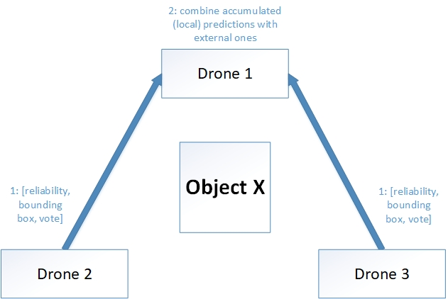
Protocol Design
Intra-host
Inter-host
Aggregate local predictions with received ones
Weighted average over the set of predictions
Emission of final result
Challenges
Give the proper weight to each device’s prediction
Reach a consensus
Handle packet losses
What? – Related Work – How? – Progress
École polytechnique fédérale de Lausanne – A.Y. 2018/2019 – Marco Zoveralli – Sciper N. 267476
1/11
4/4
Notes:
Infer about BIP, say that we discuss later about the tools

Slide 29


Slide 30
Protocol Design
Intra-host
Local predictions accumulated in an “opinion vector”
Exponential weighted moving average to update the information
Accumulated information: prediction score, bounding-box/image ratio
Results propagated after some predictions
Inter-host
Aggregate local predictions with received ones
Weighted average over the set of predictions
Emission of final result
Challenges
Give the proper weight to each device’s prediction
Reach a consensus
Handle packet losses
What? – Related Work – How? – Progress
École polytechnique fédérale de Lausanne – A.Y. 2018/2019 – Marco Zoveralli – Sciper N. 267476
1/11
4/4
Notes:
Infer about BIP, say that we discuss later about the tools

Slide 31
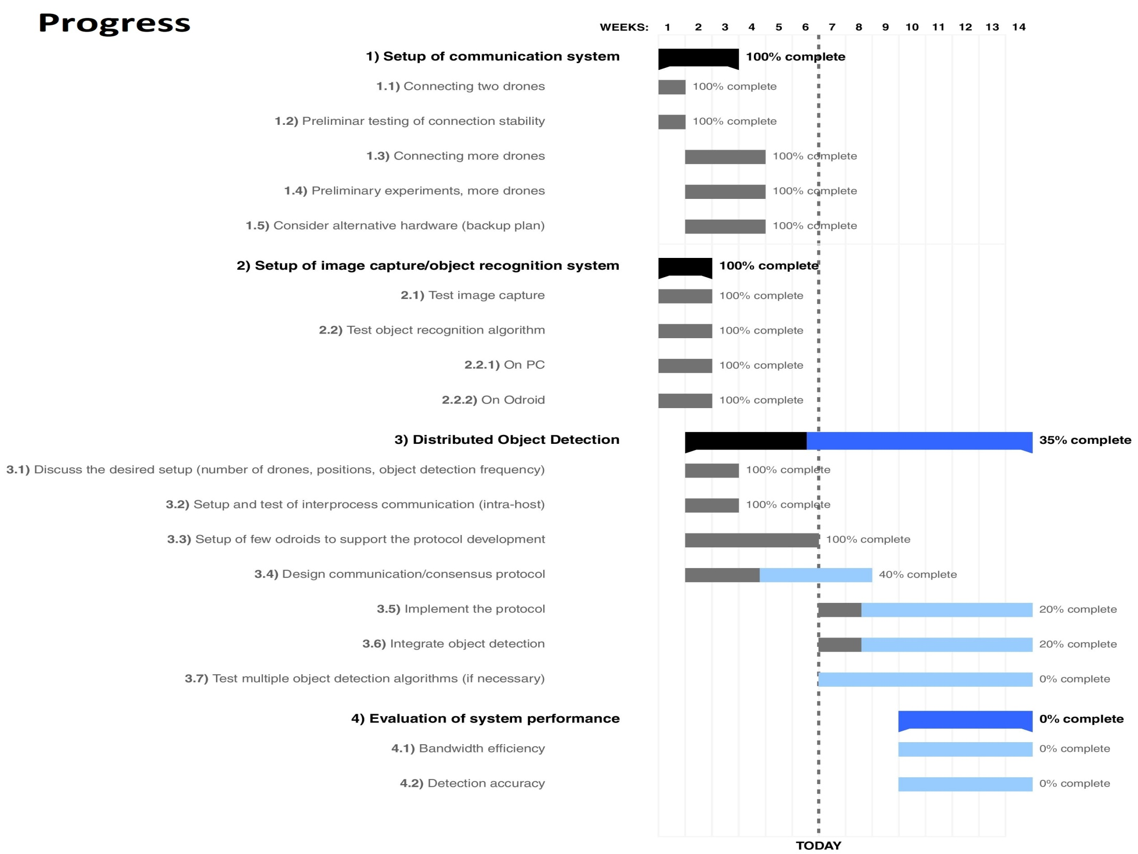
Simple Network Management Protocol
Model Checking: Abstraction VS Refinement
Why? – What? – How? – Progress – Conclusion
École polytechnique fédérale de Lausanne – A.Y. 2016/2017 – Marco Zoveralli – Sciper N. 267476
7/26
Notes:
What does model checking do? A little background.

Slide 32
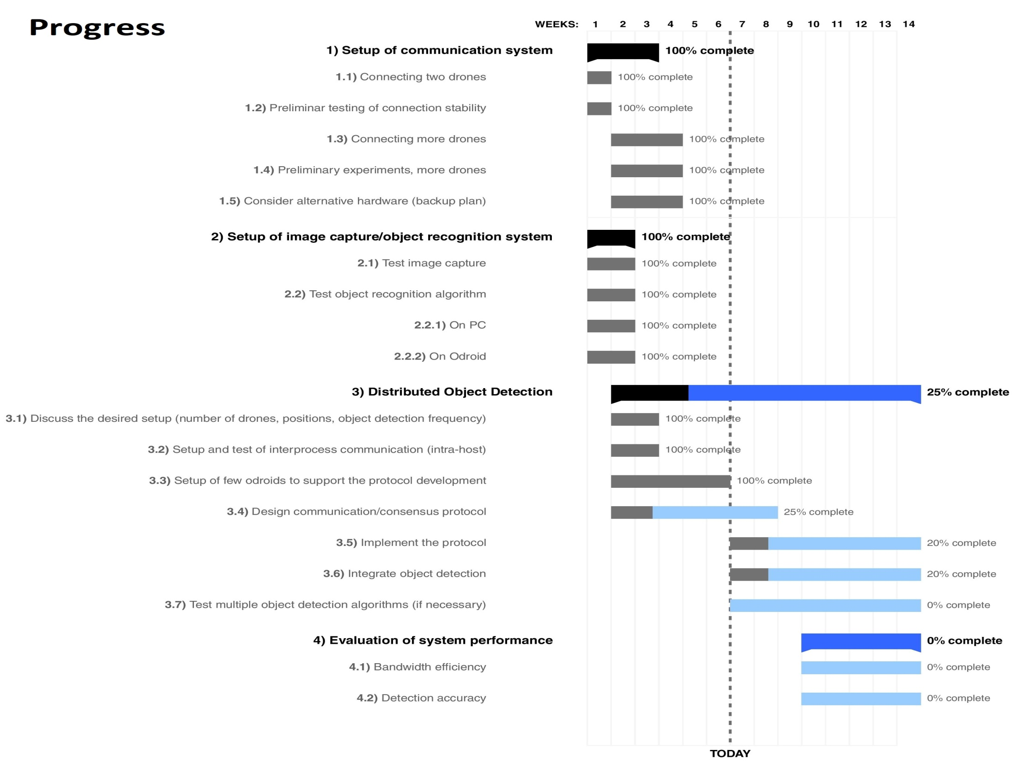
Simple Network Management Protocol
Model Checking: Abstraction VS Refinement
Why? – What? – How? – Progress – Conclusion
École polytechnique fédérale de Lausanne – A.Y. 2016/2017 – Marco Zoveralli – Sciper N. 267476
7/26
Notes:
What does model checking do? A little background.

